Slide 1


Exploratory Data Analysis Capstone Project
Topic- Global Terrorism
Submitted by- Subhasis Chattopadhyay
E-mail id- subhasischattopadhyaydbb@gmail.com

Slide 2
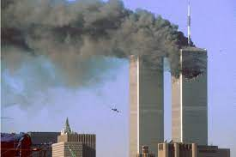
Terrorism
Terrorism is defined in the Code of Federal Regulations as “The unlawful use of force and violence against persons or property to intimidate or coerce a government, the civilian population, or any segment thereof whether ethnic or religious, in furtherance of Political or Social or Religious objectives”.

Slide 3
Data Pipeline
Data Processing-1: There were many columns with null values that has to be removed, total 15 columns has more than 90% of it’s values as null values.
Data Processing-2: We had to manually go through the data set in order to get a rough idea of what all informations can be extracted from this dataset.
EDA: In this part, we carried out the Exploratory Data Analysis on the Dataset obtained after processing the data received after completing above mentioned processes.
Conclusion: Finally, on the basis of the information extracted from the EDA, we obtain the summary of our Analysis.

Slide 4
Exploratory Data Analysis(EDA)
Terrorist attacks over the years from 1970 to 2017
Most Terror affected Countries
Region-wise Distribution of Terrorism
Most affected Cities in the Geo-Political regions of the world
Most affected States in top 5 Terror affected Countries
Most common Mode of Terrorism
Most Preferred Weapon of Terror
Year on year analysis of Terror attack in most affected countries
Most Notorious Terrorist Organisations
Country-wise activities of most notorious Terrorist Organisations
Most Vulnerable Terror Targets
Year-wise analysis of Casualties of Terrorism
Co-relation between No.of Terrorist Organisations active in a Country and Terrorist attack

Slide 5
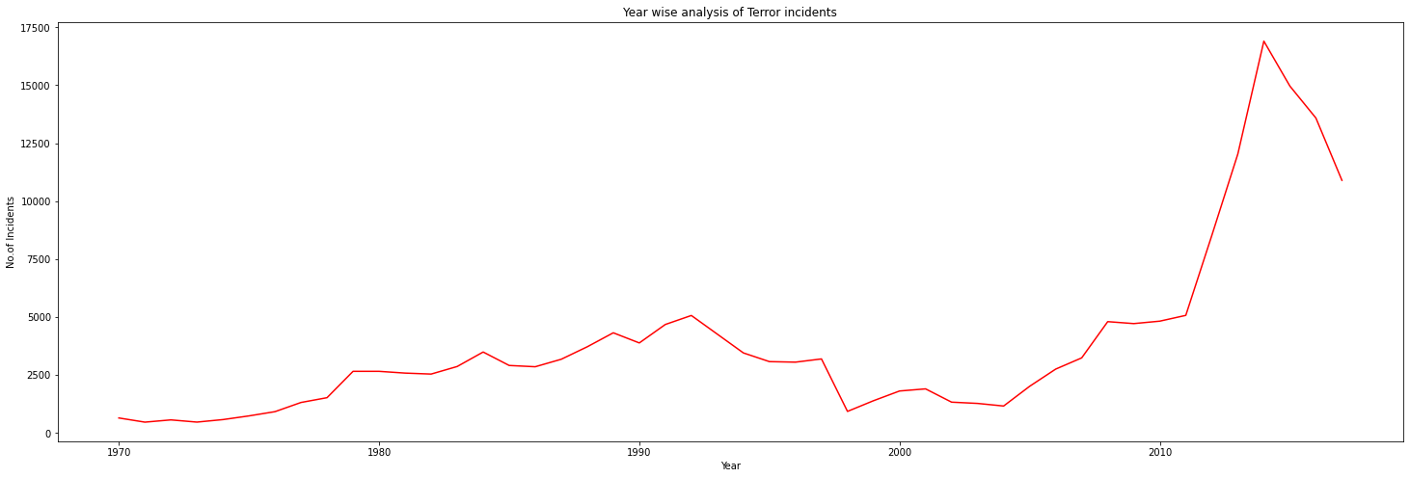
Terrorist attacks over the years from 1970-2017

Slide 6
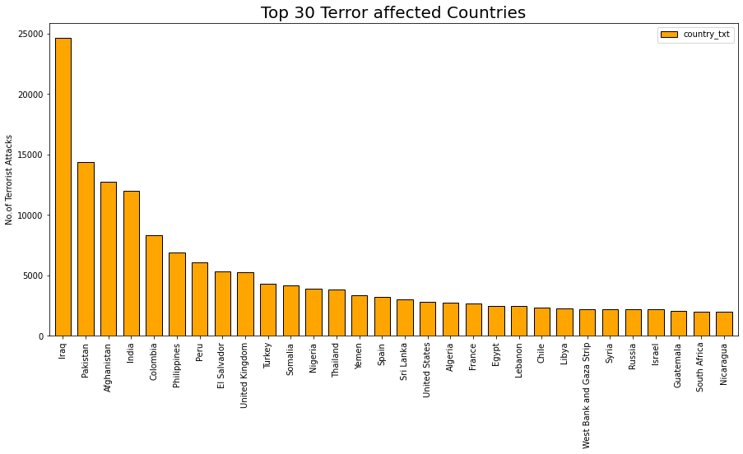
Most Terror affected Countries

Slide 7
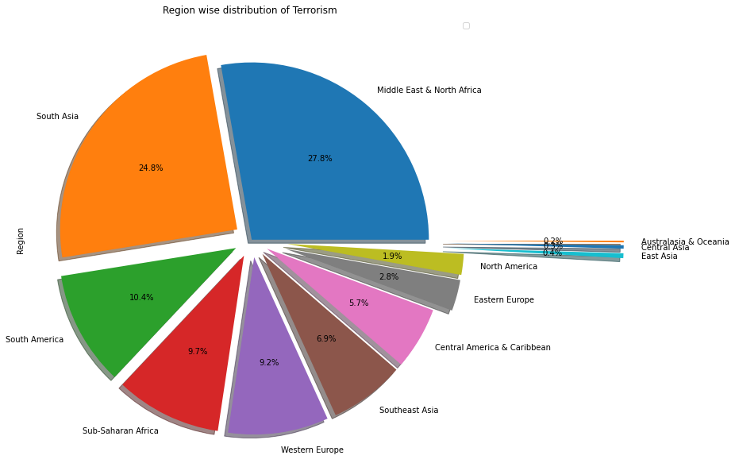
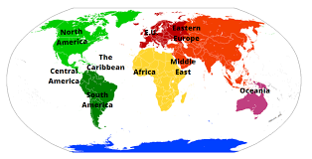
Region-wise Distribution of Terrorism

Slide 8
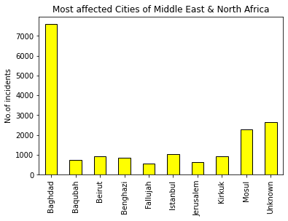
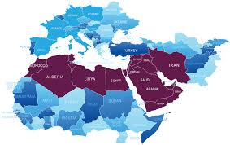
Most affected Cities in each Geo-Political regions of the world
Middle-East and North Africa

Slide 9
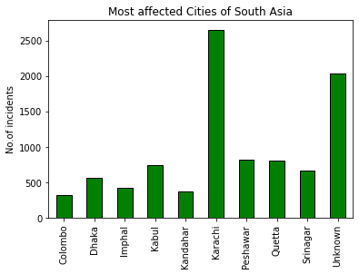
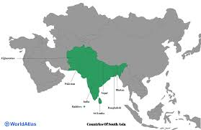
South-Asia

Slide 10
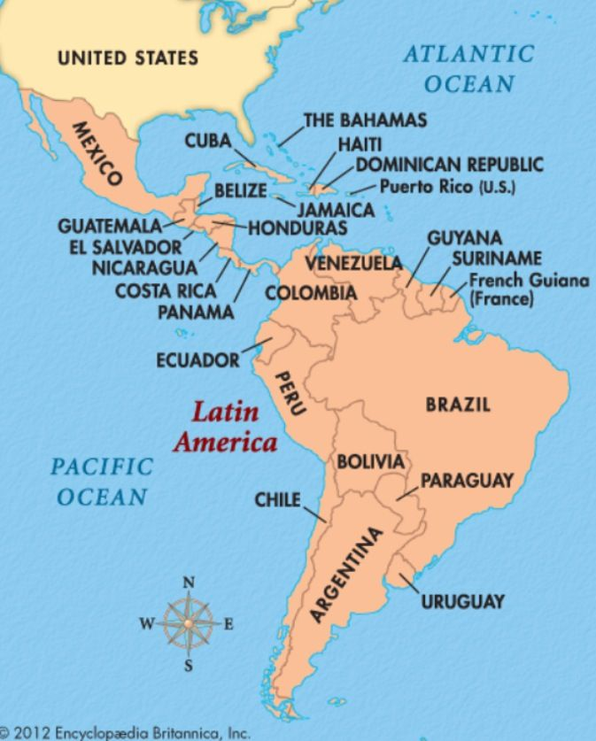
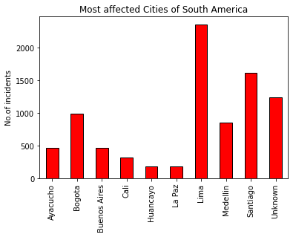
South-America

Slide 11
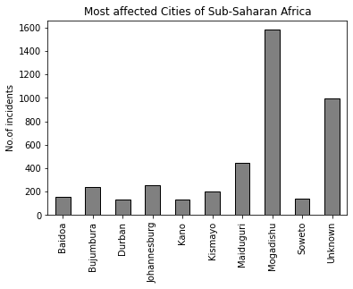
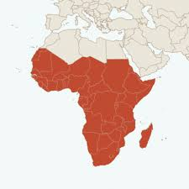
Sub-Saharan Africa

Slide 12
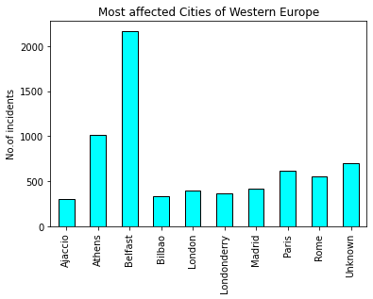
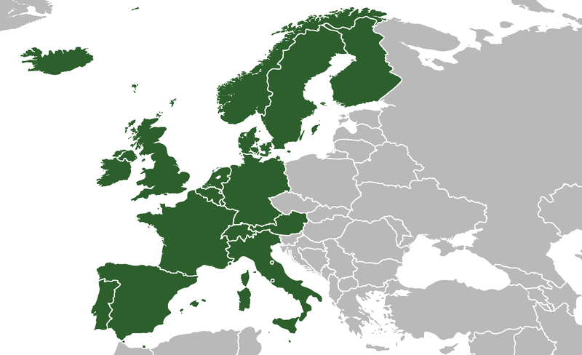
Western Europe

Slide 13
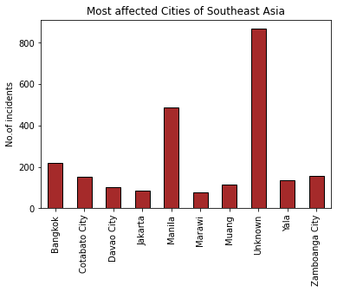
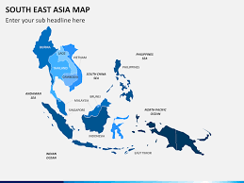
South-East Asia

Slide 14
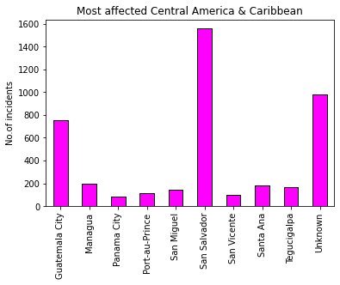
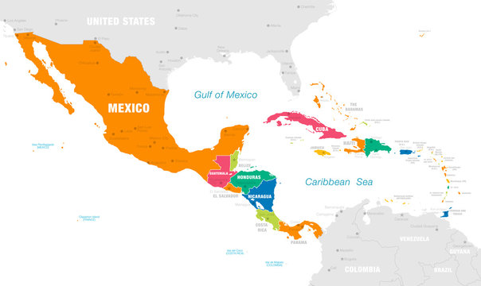
Central-America and Caribbean

Slide 15
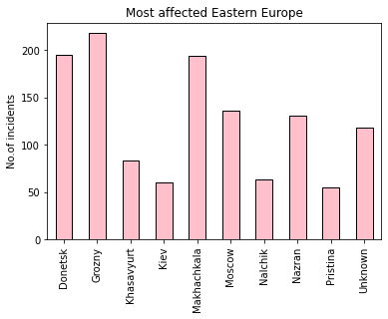
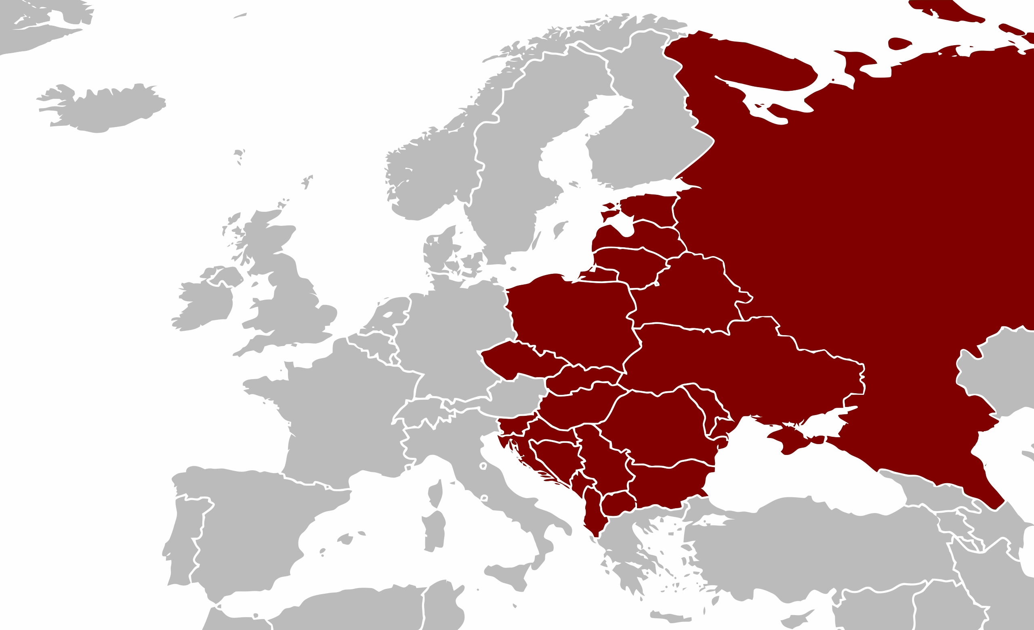
Eastern Europe

Slide 16
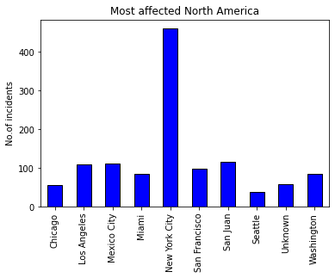

North-America

Slide 17
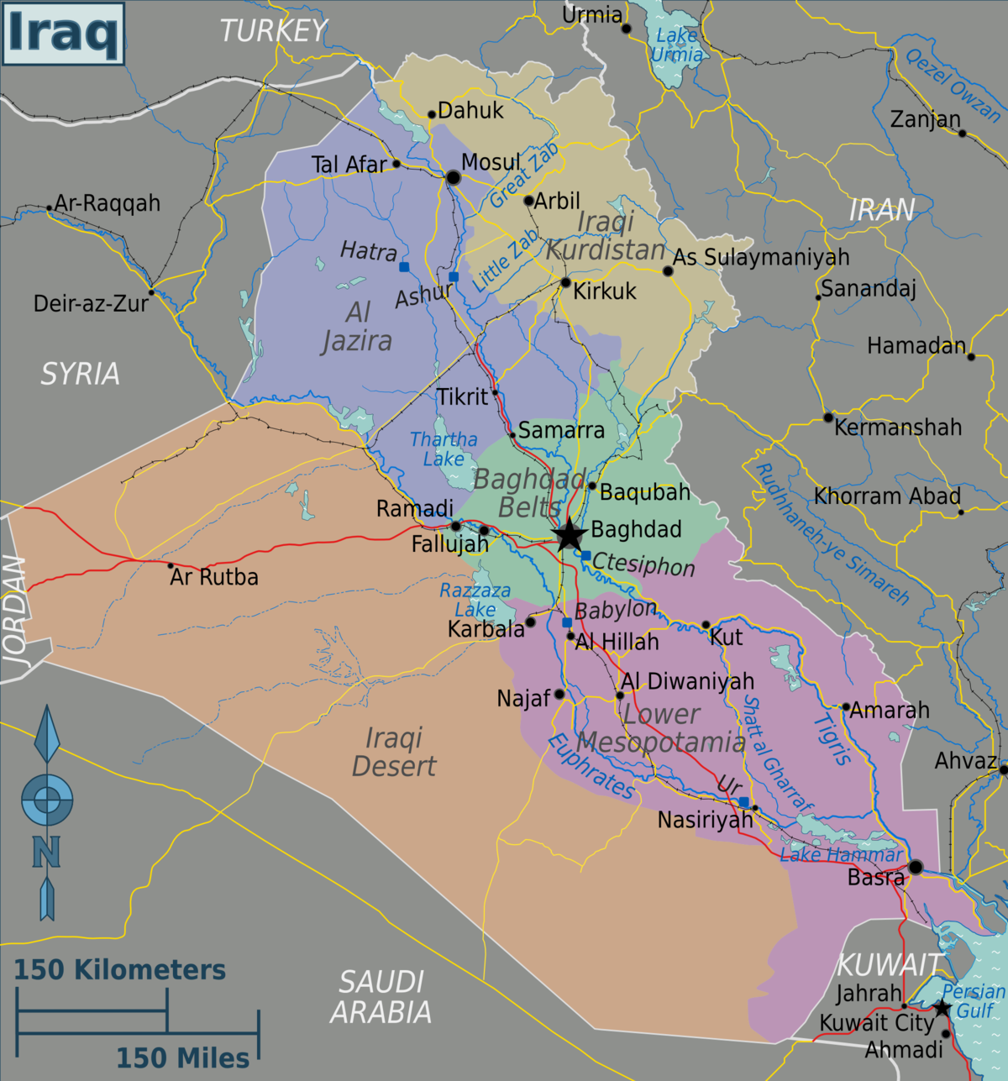
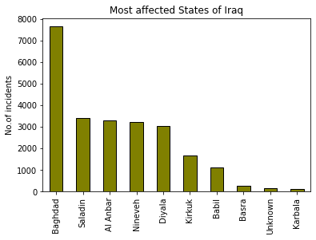
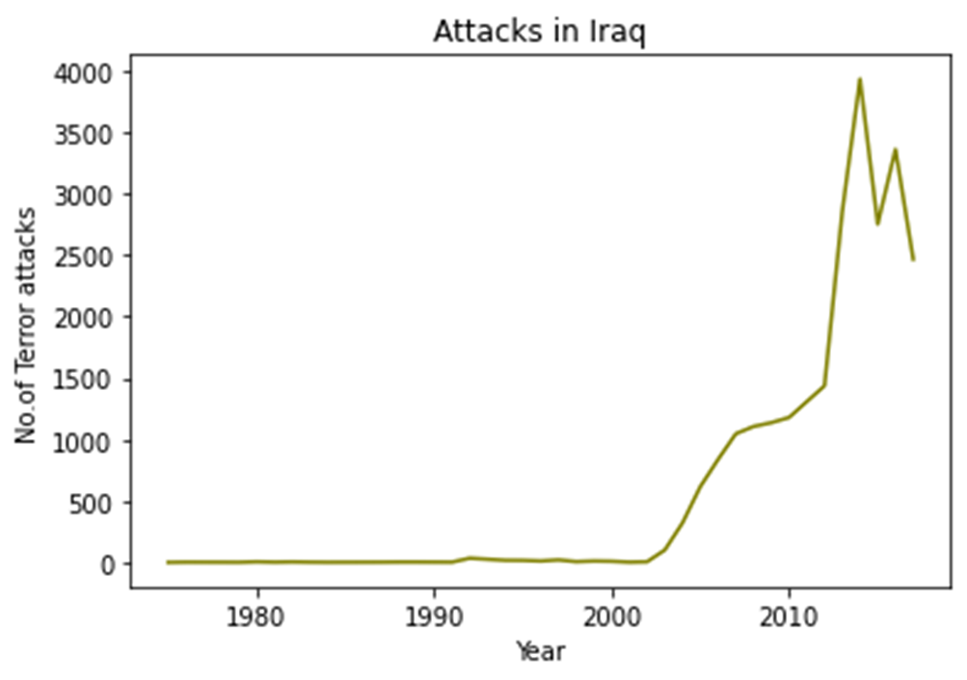
Analysis of Top 5 Terror affected Countries
Iraq

Slide 18
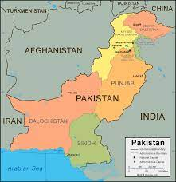
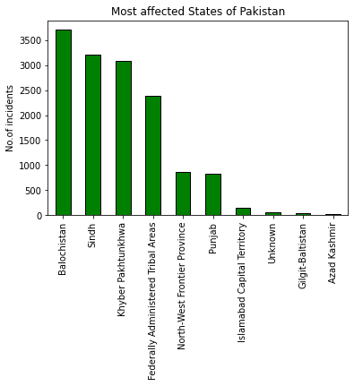
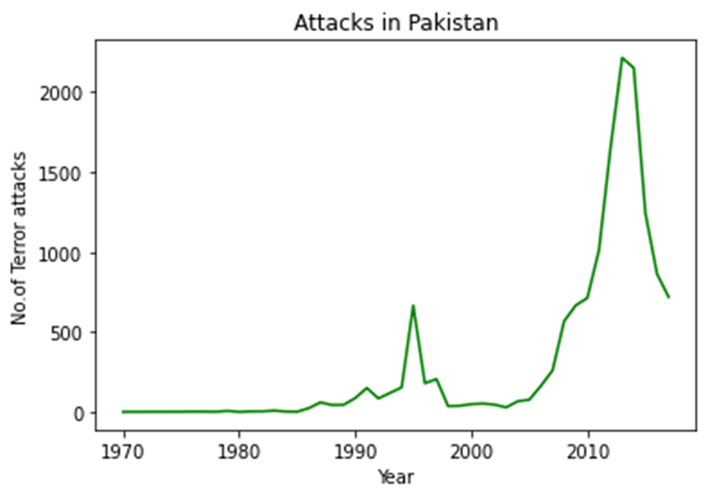
Pakistan

Slide 19
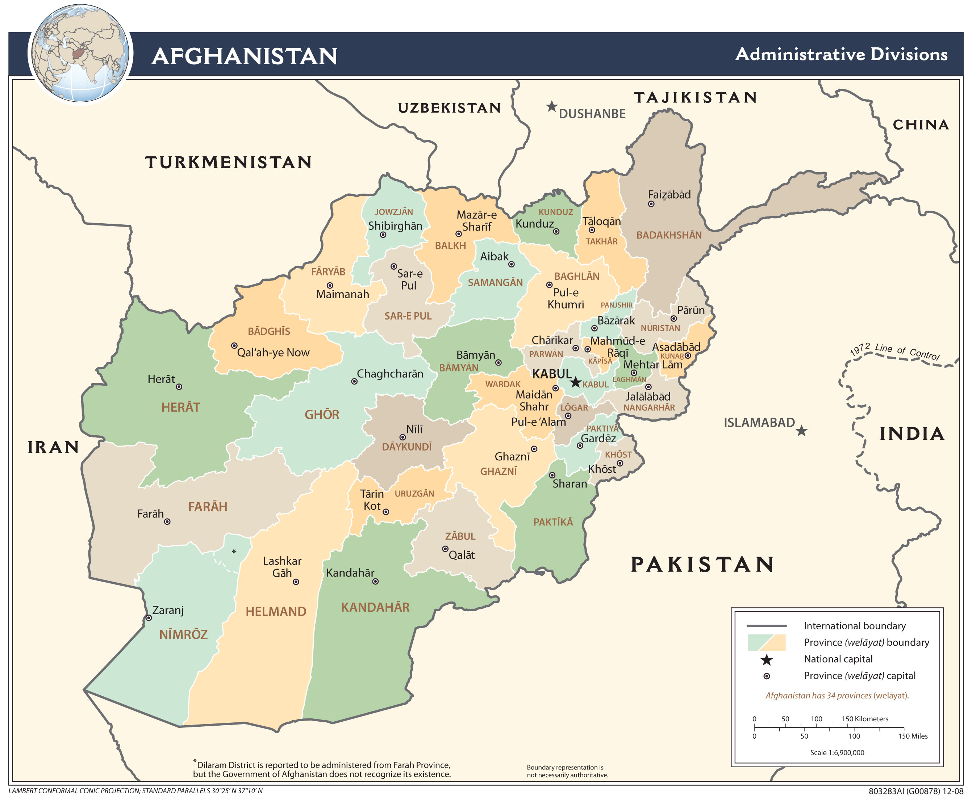
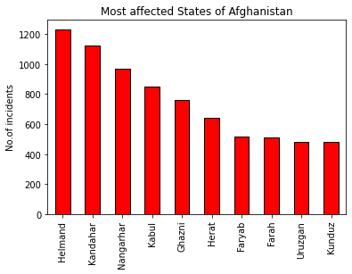
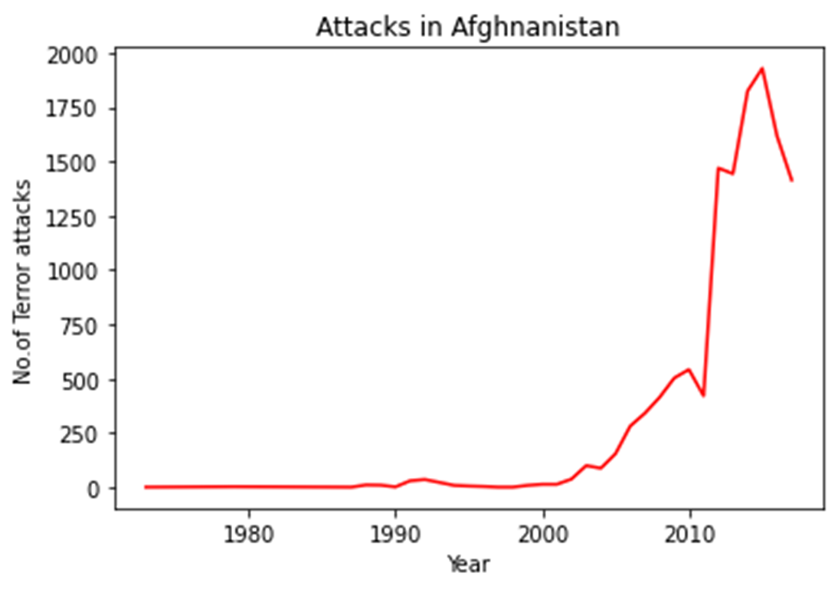
Afghanistan

Slide 20
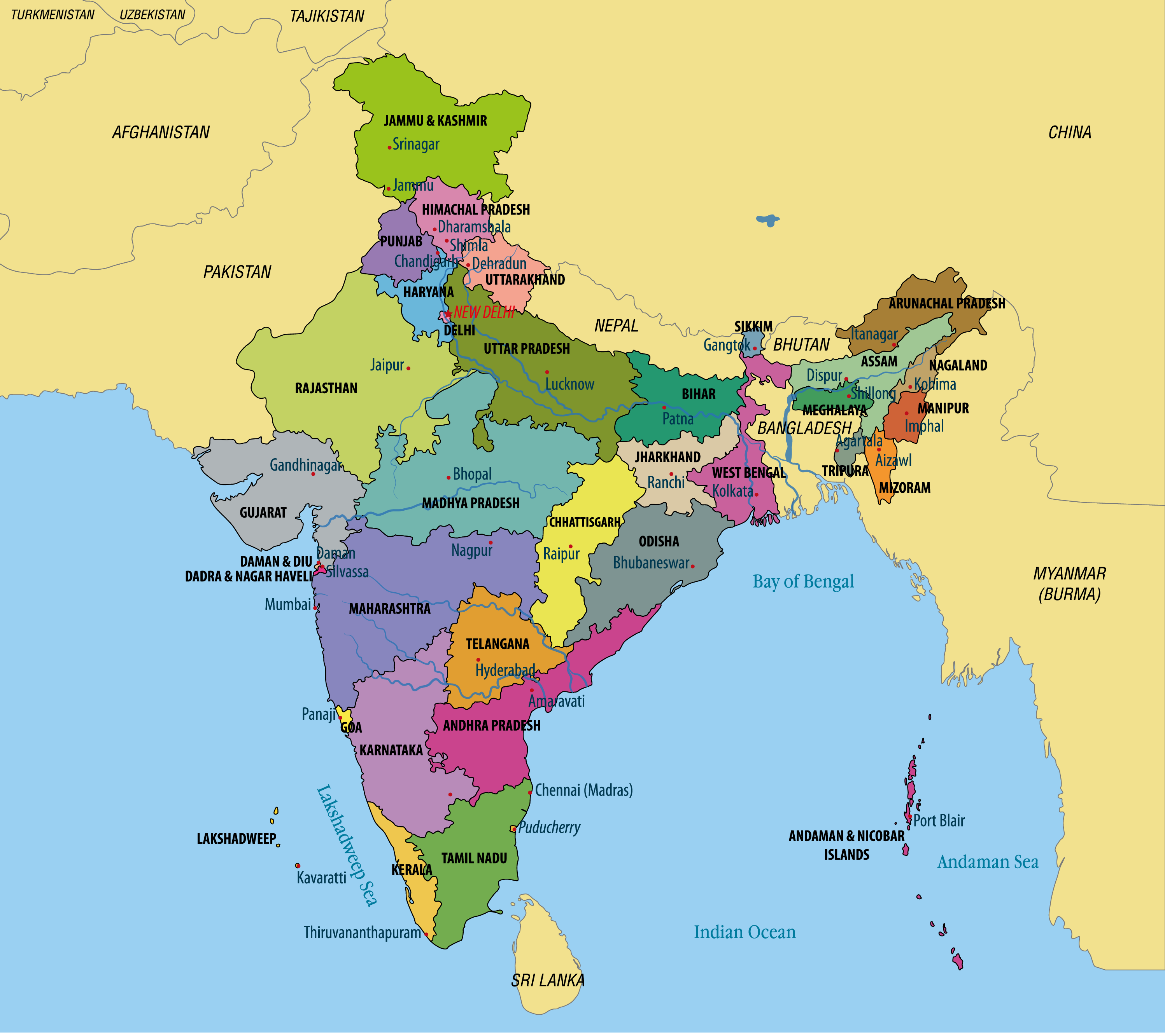
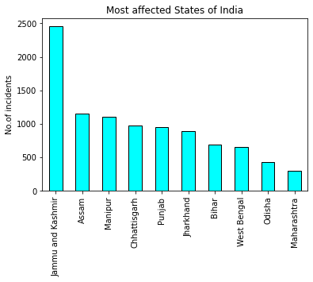
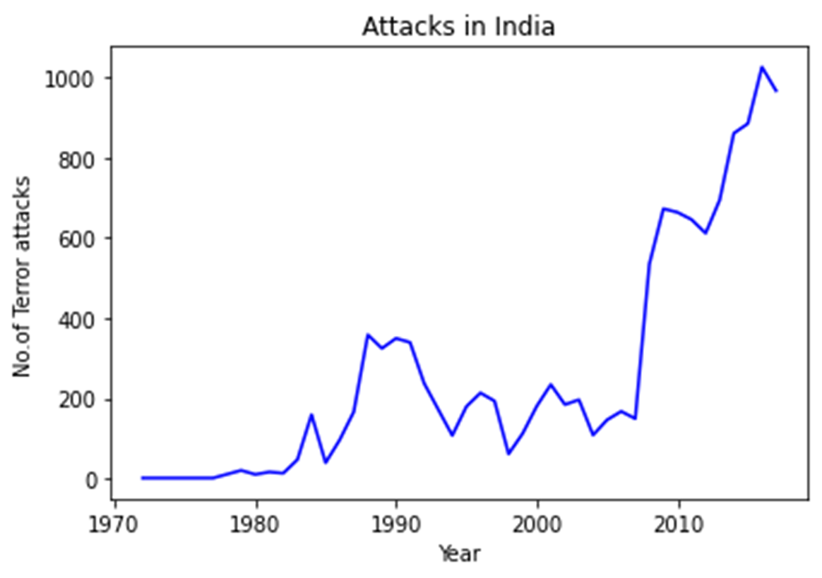
India

Slide 21
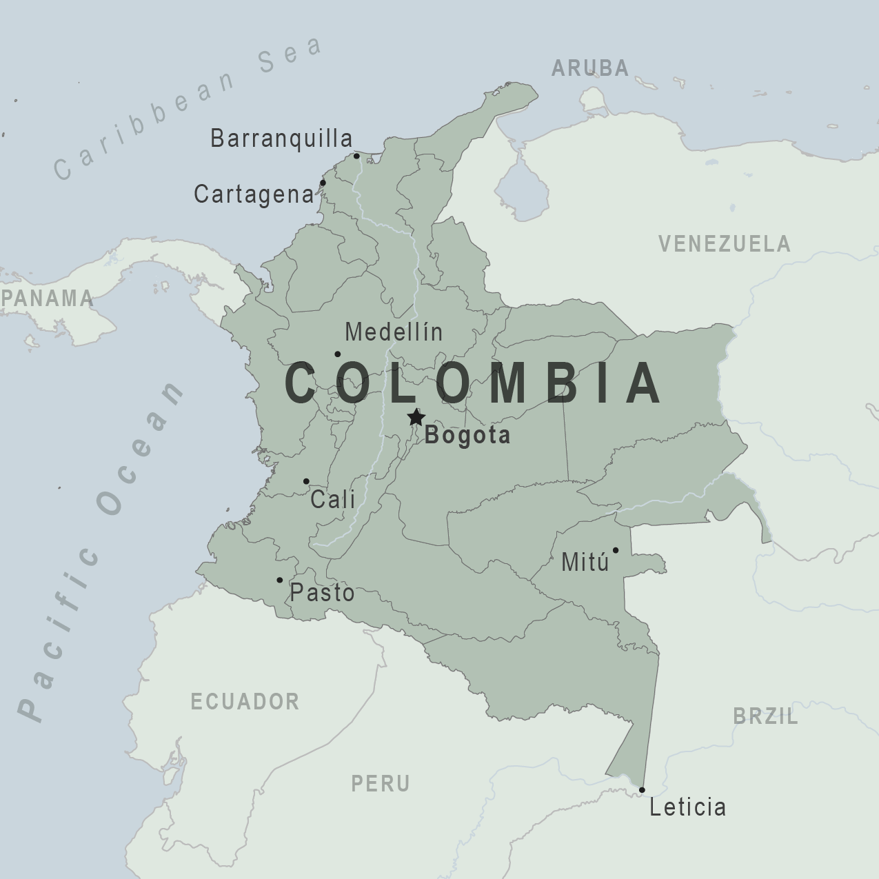
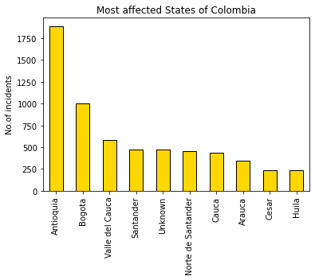
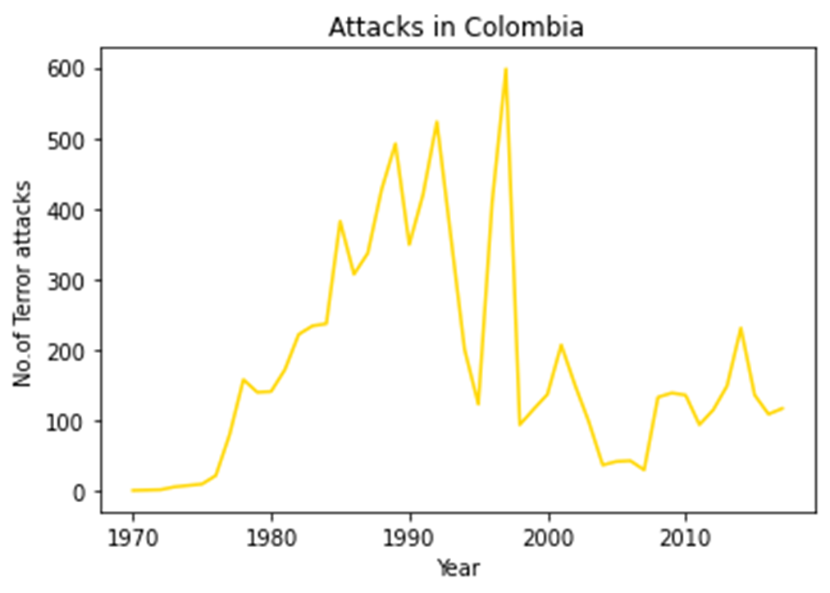
Colombia

Slide 22
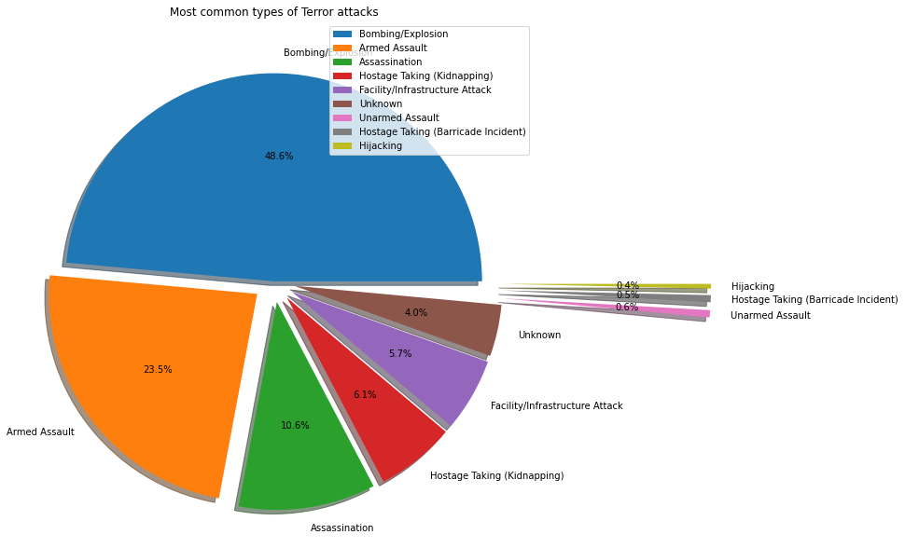

Most common types of Terror attacks

Slide 23


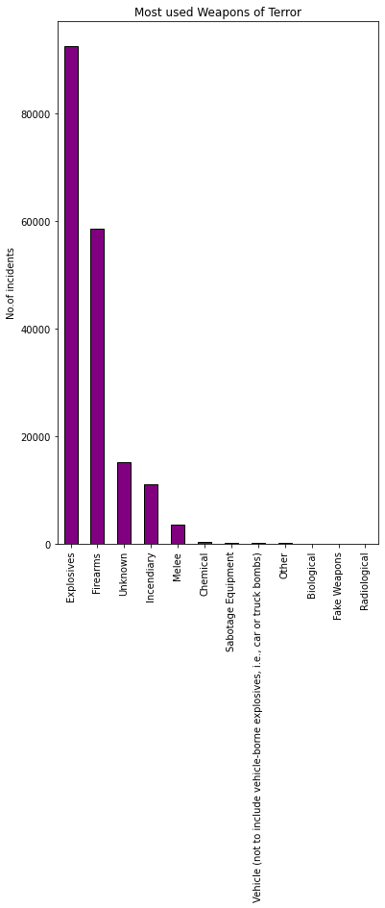
Most Preferred Weapons of Terror

Slide 24
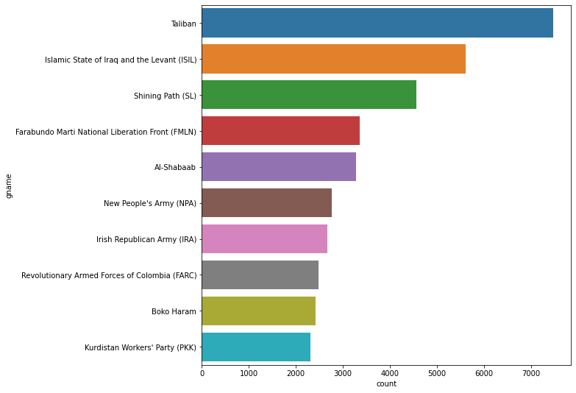
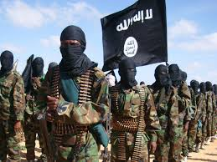
Most Notorious Terrorist Groups

Slide 25
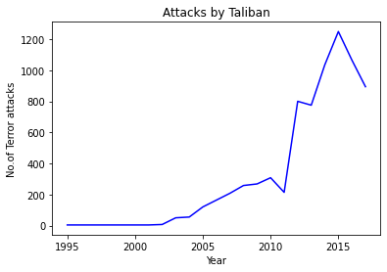
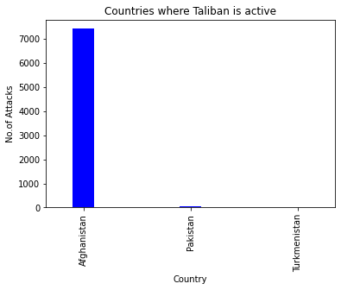
Taliban

Slide 26
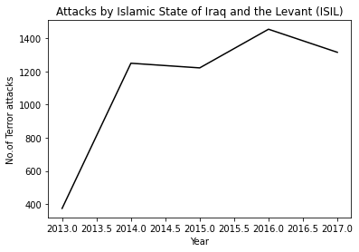
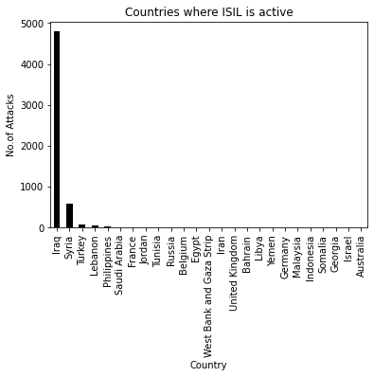
Islamic State of Iraq and Levant(ISIL)

Slide 27
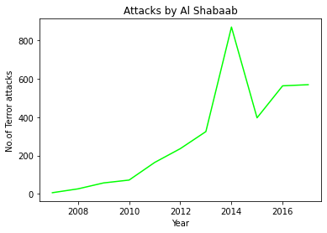
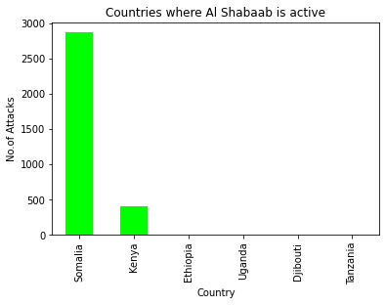
Al-Shabaab

Slide 28
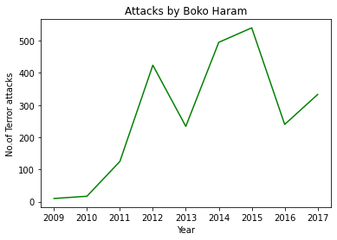
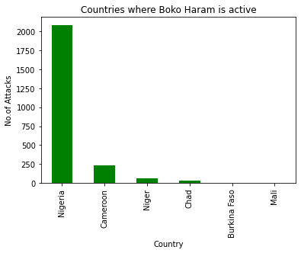
Boko Haram

Slide 29
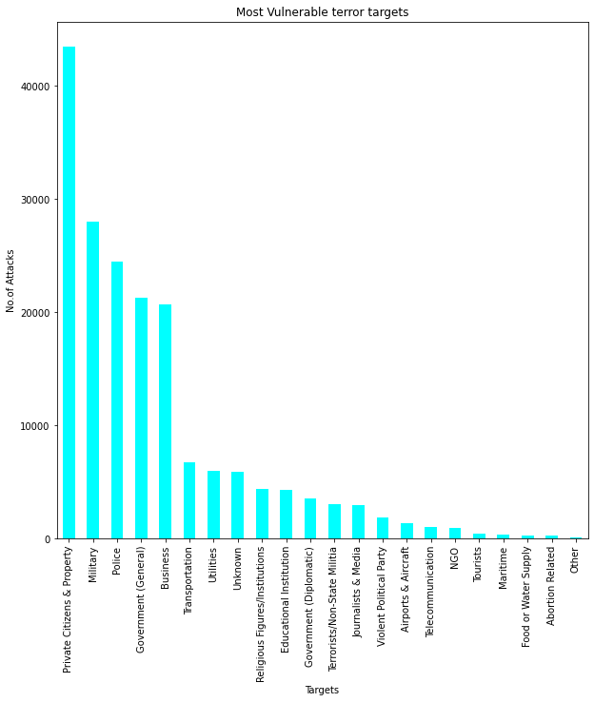

Most Vulnerable Targets of Terror Attacks

Slide 30

Year wise analysis of Casualties of Terrorism
The above bar chart gives us the understanding about people killed due to terror attacks
total people killed is 4,11,868
The lowest in the year 1971 is 171 and highest in in the year 2014 is 44,490 which is so sad.
The data gives us idea on the reduction of numbers from 2014 to 2017 gradually.

Slide 31

Wounded in Terror Attacks
The below visualization will give us better idea about no of people injured with terrorism.
The lowest is in the year 1971 : 82 , the highest in in the year 2015: 44043
The total number of people injured till 2017 is: 5,23,869
The graph indicates the decrease in number from 2015 to 2017.

Slide 32


Co-relation between No.of Terrorist Organisations active in a Country and Terrorist attack

Slide 33

Analysis Result

Slide 34
Conclusion
Terrorism has been on the rise from 1970 upto 1993 then there was a gradual decrease till 1998 followed by steady increase upto 2010 after that a sharp rise is being observed that peaks in 2014 again followed by a sharp decrease.
In the list of top terror affected countries, surprisingly many countries were from North America and East Asia which are rarely in the news media, this shows how the World media ignores the plight of a large section of Human Population.
Bombing/Explosion and Armed Assault are the major mode of Terror attacks used by Terrorist Groups followed by Hostage taking.
Hijacking has greatly reduced which proves the effectiveness of modern equipments ensuring safety and security at high security zones.
Explosives (like Car bomb, Rocket launchers and Mortars) and Guns (like Assault rifles and Pistols) are mostly preferred by Terrorists, Intelligence Agencies must ensure tight control over the availabilities of these or its parts in the black market.
Among all other terrorist organization, the ISIL is the newest organization which came into being in 2013 and has spread into a large no.of countries within a very short span which is particularly concerning to Global Peace, it’s ideology and motivation must be countered by Global Media and De-radicalization of youth is necessary.
Global Terrorism is declining from 2014, activities of most Terror outfits is seen to drop which is a good sign for Global Peace.
In most cases, No.of Terror attacks is directly related to the no.of Terror outfits active in the country but exceptions are also there.
A total of 411868 persons killed and 523869 people wounded till date.
India has one of the highest no. of active terror outfits yet much lower attacks compared to other countries, this proves that our Intelligence Agencies are doing a pretty good job.

Slide 35
THANK YOU

